Slide 1
Teaching Physical activity to children with vi-Counselor Training Program
Lauren J. Lieberman
Kristi Lane
Matthew Farwell
Rachel Sherman

Slide 2
Camp Abilities Coaches/Counselor training
The purpose of this PowerPoint is to guide the Camp Abilities Coaches Training that takes place before coaches/counselors teach and coach youth with visual impairment during Camp Abilities educational sports camps.

Slide 3
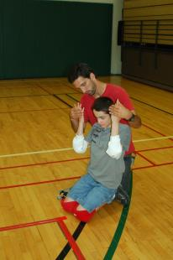
Summary of the camp abilities coaches training
Philosophy Statements
Visual Impairment Overview
Sports Overview
Teaching Strategies
Modifications, Adaptations, Accommodations and Safety
Socialization Facilitation
Advocacy Strategies
Conclusions

Slide 4
Philosophy of camp abilities
WHAT IS THE MISSION OF CAMP ABILITIES?
WHAT ARE THE OVERALL OBJECTIVES OF CAMP ABILITIES?
HOW IS CAMP ABILTIES CONNECTED TO THE EXPANDED CORE CURRICULUM?
Notes:
Mission= is to empower children and teens with visual impairments to be physically active and productive members of their schools, towns, cities, and communities, as well as to improve the health and well-being of people with sensory impairments.
Other purposes- train future professionals, provide respite time for families, a vehicle to assist children with disabilities to be active community members, and continuing research in the field of VI
ECC- hit all 9 components during camp, can include ECC assessment

Slide 5
VISUAL IMPAIRMENT OVERVIEW
WHAT IS THE ETIQUTTE WORKING WITH A PERSON WHO IS BLIND
WHAT ARE VISUAL IMPAIRMENTS?
ORIENTATION AND MOBILITY TIPS
HUMAN GUIDE
EMPOWERING CHILDREN WITH VI TO BE INDEPENDENT IN ACTIVITIES OF DAILY LIVING

Slide 6
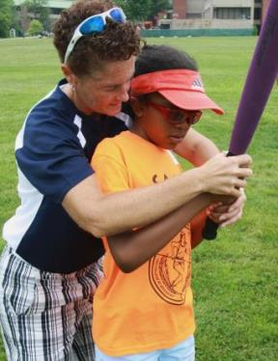
How To Work with athletes who are blind
How To Treat A Person Who Is Blind Handout
Ask your athlete what they need to be successful
Make your athlete comfortable
Provide challenge by choice opportunities
Explain the different concepts of activities
Avoid the “Disney Voice”
Expectations are high for athletes, teach form right
Achievement vs. Participation
Notes:
Challenge by choice= giving opportunity to try things at own comfort, (eg. Wearing an eye shade first time doing an activity)

Slide 7
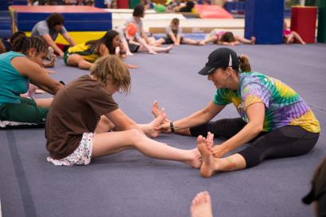
How to work with athletes who are blind continued
Athletes can participate in closed and open sports
Open: offense and defense (Basketball, Soccer, Football, Volleyball)
Closed: Environment is consistent (Shot-put, Archery, Golf, Gymnastics)
Reach out for assistance if you are uncomfortable
Ask your group leader, O&M specialist, other coaches, and TVI’s for help

Slide 8
Vision Background
Visual Acuity
Sharpness of vision, reading numbers and letters from the chart
Visual Field
Entire area that a person can see with eyes fixed in one position
Myopia
Nearsightedness
Strabismus
Inability to align both eyes in the same direction

Slide 9
Vision Background
Albinism
Little to no production of Melanin impacts development of optic nerve in eyes
Photophobia- sensitivity to light
Nystagmus
Rapid, involuntary movement of the eyes back-and-forth
Retinopathy of Prematurity
Retinas scarred usually found in premature infants
Cataracts
Opacity of the lens of eyes.

Slide 10
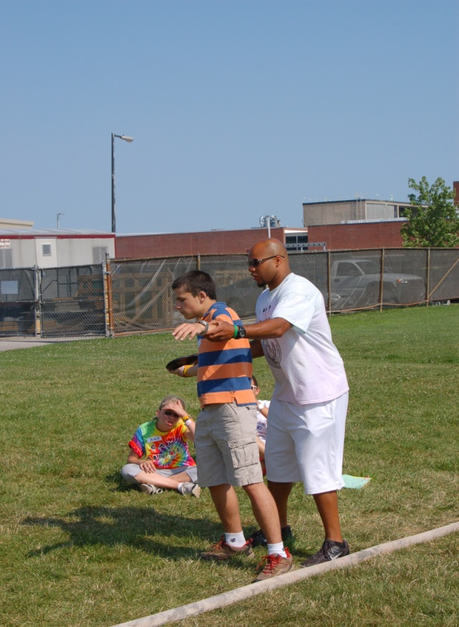
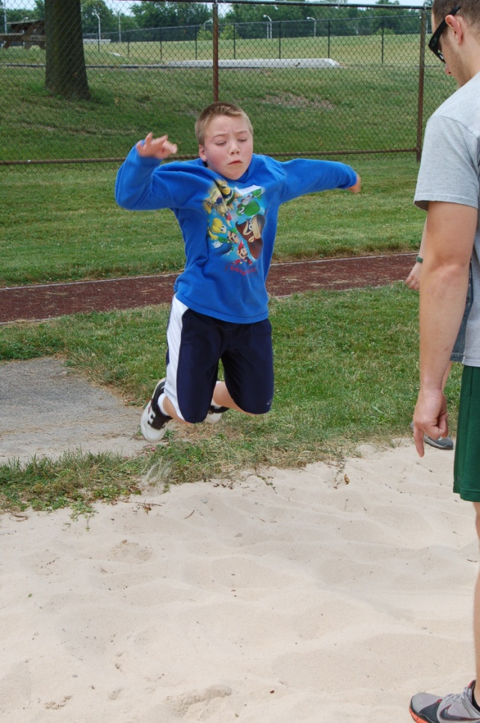
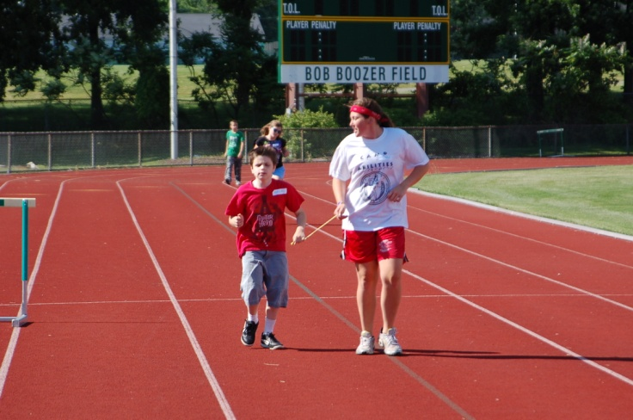
Why Are motor skills Important?
Notes:
Jessica

Slide 11
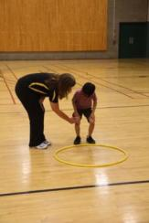
Developmental Progression of Locomotor Skills
Running
Jumping
Galloping
Hopping
Sliding
Skipping
Notes:
Jessica

Slide 12
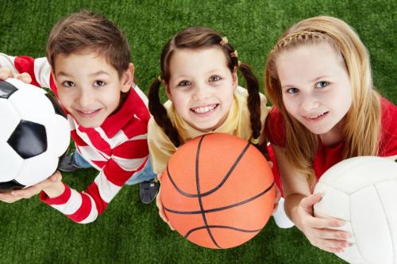
Foundation to Fitness
Physical activity levels at each life stage influence the child’s level of of engagement in sports, fitness, and recreational activities later on in life
Children’s fundamental skill competence is the primary, underlying mechanism that promotes engagement in physical activity

Slide 13
SPORTS OVERVIEW
LIST ALL OF THE SPORTS THAT YOU DO AT YOUR CAMP HERE

Slide 14
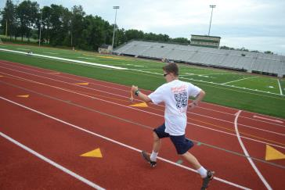
SPORT EXAMPLE: RUNNING
Make sure athletes know options – provide choice!
Guidewire, tether, human guide, sound source
Understand different running terrains might require different techniques
Stress proper form
Teach each component
Notes:
Assess for process and product separate and not together
Process- running form, shouldn’t be forced to do form and for a time goal
Product- Run a mile- focus on time and not as much on form

Slide 15
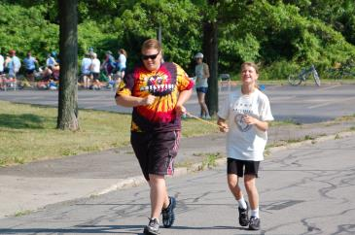
Guide Running Techniques
Be dynamic!
Progress from guidewire to tether etc.
Choice is important for skills to generalize to other environments
It is the guide's responsibility to provide verbal cues to the athlete on matters such as upcoming hills, turns, curbs, uneven footing, where other competitors are in the race, times, etc.
Guide’s ability must exceed or match the camper
It is important that the guide runner be a faster runner than the blind athlete
This will allow the guide to focus on the needs of the blind athlete and not be concerned with their ability to keep up the pace.
USABA Basics of Guide Running for Track & Field and Trail
Camp Abilities Track Video
Camp Abilities XC Video

Slide 16
TEACHING STRATEGIES
ASSESSMENT
PROMPTS
GUIDANCE: TACTILE MODELING, COACTIVE MOVEMENT, PHYSICAL GUIDANCE
BEHAVIOR STRATEGIES

Slide 17
Pre teaching: Whole – part - whole
The entire activity is presented first so that athletes understand what they are going to attempt to accomplish
The activity is then broken down into its component parts, which are taught and practiced
Finally, the athletes put the parts together into the whole activity or skill.
Example 1: Use tactile boards prior to exploring the field of play or court
Example 2: Show and explain equipment prior to teaching the unit

Slide 18
Pre teaching: hierarchy of Prompts
Natural Cue/ Independence
Visual Prompt
Verbal Prompt
Gestural Prompt
Modeling
Partial Physical Prompt
Full Physical Prompt
Most to least restrictive

Slide 19
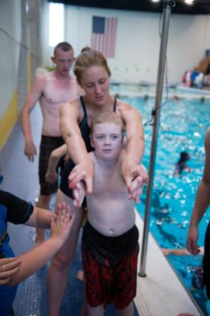
Instructional Strategies: Teaching techniques
Which is the athlete’s preferred method of learning?
Physical Guidance – instructor guides the athlete through the motions of a skill
Tactile Modeling – athlete feels the instructor or peer go through the motions of a skill
Coactive Movement - Both the instructor and athlete perform the same movement at the same time together
Notes:
Be sure to add that you have to ALWAYS ask before making physical contact

Slide 20
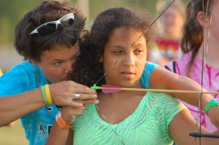
Instructional strategies Continued
Show athletes their options of teaching techniques
Ask the athlete what their preferred method of learning is
What are they comfortable with?
Let them know there are multiple ways to learn
Combine different techniques
Use appropriate cues
Let athlete know what you are doing before you do it!
Notes:
Jessica

Slide 21
MODIFICATIONS
WHAT IF THE SPORT/PROGRAM IS NOT MEETING THE NEEDS OF THE CHILD?
MODIFICATIONS/ADAPTATIONS
ACCOMMODATIONS

Slide 22
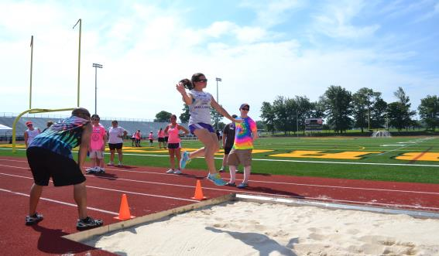
modifications
Understand B1, B2, and B3 classification related to sight and needs
Do not assume modifications needs to be made!
USABA Sport Adaptations

Slide 23
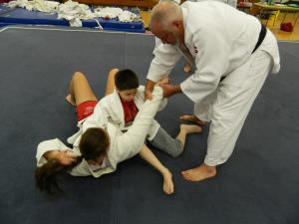
Environment Modifications
Tactile Boundaries
Bubble wrap boundaries
Uniforms can be brighter recognized colors
Size of the court
Can be made bigger or smaller to fit the needs of the athlete
Rules can change as long as they do not effect the main objective of the sport
Example: Wrestlers begin
by maintaining contact

Slide 24
Equipment Modifications
Brightly colored objects
Neon colored balls, bright scarves
Auditory objects
Ex. Beeping ball, sound box, ball with bells
Size of the object
Small vs. medium vs. large
Texture of the object
Yarn ball, Gatorball, playground ball

Slide 25
Instructional Modifications
Visual Prompts
Skill posters
Related cues
Examples
Level of Assistance
Total vs. partial

Slide 26
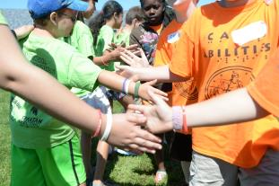
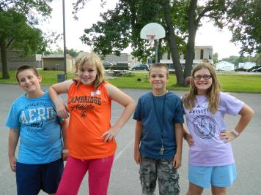
SOCIALIZATION FACILITATION
Teach appropriate socialization
Ex: How to begin conversation
Interactions between athletes
Encourage athletes to sit with peers at meals
Encourage athletes to walk to activities with peers
Facilitate pairs when needed to prevent cliques
Encourage contact info. exchange between athletes after camp
Email
Facebook
Provide contact information for all
Athletes to ensure continues relationships
Notes:
Staff social media, remind that posts on personal media may not be covered depending on your camp’s waiver

Slide 27
ADVOCACY
SOME WAYS TO FACILITATE HAVING CHILDREN WITH VI PARTICIPATE BEYOND CAMP…
Role play scenarios
Provide athletes with scripts
Guest Speakers
Paralympians
Testimonials
Former Campers & Paralympians
Panels
Campers & Parlympians
Individuals from the community

Slide 28
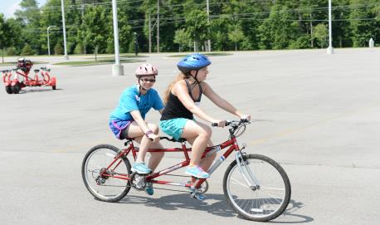
How to ensure involvement in sports
Give opportunities – afterschool, camps, within community
Teach the students advocacy
Support parent needs
Notes:
Lavelle slide**requirement for NYS camps

Slide 29
CONCLUSIONS
REMEMBER YOUR PURPOSE AND CAMP PURPOSE
INFILTRATE CAMP MISSION INTO EVERY ACTIVITY OF THE DAY

Slide 30
Resources
Athletics For All
Team USA Mobile Coach
Leveling The Playing Field
Beep Kickball
US Games
Flaghouse
The Braille Superstore
American Printing House For The Blind
United in Stride

Slide 31
Special Thanks to the many people that helped create this training PowerPoint
Monica Lepore Scott McNamara
Maria Lepore Stevens Lisa Hanson
Carla Morrow Joslei Viana de Souza
Lisa Santos Rita Costa
Anna Pipchinski Tiffany Mitrakos
Robbin Keating Clark Jenna Sticken
Jennifer Stelmach Leah Sterns
Kathy Beaver Matthew Mescal
Peggy Hurt Ursula Barrett
Wilma Chestnut Caitlyn Lazarus
Chris Flynt Judy Byrd
Jay Hardwig Kevin Brousard

