Slide 1
Teaching Physical activity to children with vi-Counselor Training Program
Lauren J. Lieberman
Jessica Suppa
Kelsey Linsenbigler
Alex Stribing

Slide 2
Special Thanks to the many people that helped create this training PowerPoint
Monica Lepore Scott McNamara
Maria Lepore Stevens Lisa Hanson
Carla Morrow Joslei Viana de Souza
Lisa Santos Rita Costa
Anna Pipchinski Tiffany Mitrakos
Robbin Keating Clark Jenna Sticken
Jennifer Stelmach Leah Sterns
Kathy Beaver Matthew Mescal
Peggy Hurt Ursula Barrett
Wilma Chestnut Caitlyn Lazarus
Chris Flynt Judy Byrd
Jay Hardwig Kevin Brousard

Slide 3
Camp Abilities Coaches/Counselor training
The purpose of this PowerPoint is to guide the Camp Abilities Coaches Training that takes place before coaches/counselors teach and coach youth with visual impairment during Camp Abilities educational sports camps.

Slide 4
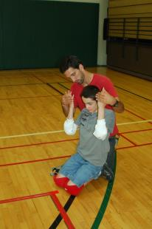
Summary of the camp abilities coaches training
Philosophy Statements
Visual Impairment Overview
Sports Overview
Teaching Strategies
Modifications, Adaptations, Accommodations
Socialization Facilitation
Advocacy Strategies
Conclusions

Slide 5
Philosophy of camp abilities
WHAT IS THE MISSION OF CAMP ABILITIES?
WHAT ARE THE OVERALL OBJECTIVES OF CAMP ABILITIES?
HOW IS CAMP ABILTIES CONNECTED TO THE EXPANDED CORE CURRICULUM?

Slide 6
VISUAL IMPAIRMENT OVERVIEW
HOW TO TREAT A PERSON WHO IS BLIND
WHAT ARE VISUAL IMPAIRMENTS?
ORIENTATION AND MOBILITY TIPS
HUMAN GUIDE
EMPOWERING CHILDREN WITH VI TO BE INDEPENDENT IN ACTIVITIES OF DAILY LIVING

Slide 7
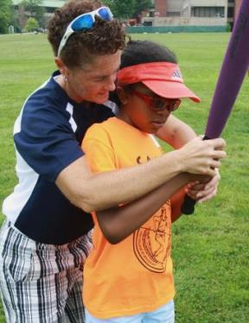
How To Work with athletes who are blind
How To Treat A Person Who Is Blind Handout
Ask your athlete what they need to be successful
Make your athlete comfortable
Provide challenge by choice opportunities
Explain the different concepts of activities
Notes:
Adam

Slide 8
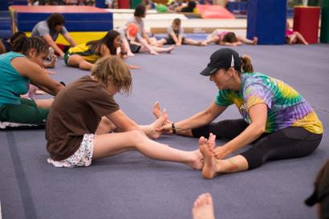
How to work with athletes who are blind continued
Athletes can participate in closed and open sports
Open: offense and defense (Basketball, Soccer, Football, Volleyball)
Closed: Environment is consistent (Shot-put, Archery, Golf, Gymnastics)
Reach out for assistance if you are uncomfortable
Ask your group leader, O&M specialist, other coaches, and TVI’s for help

Slide 9
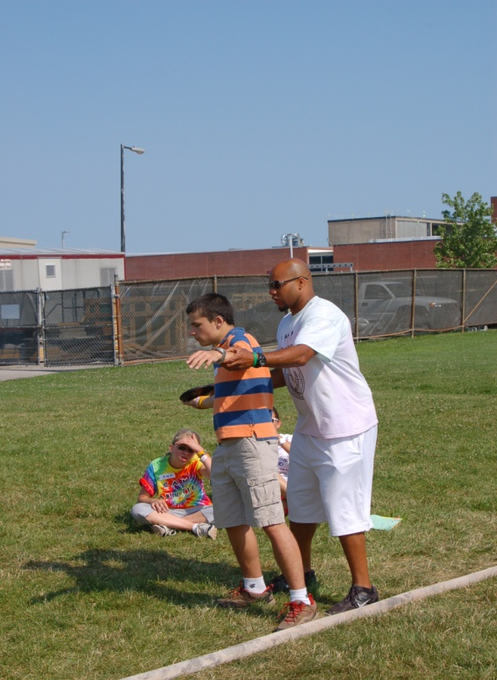
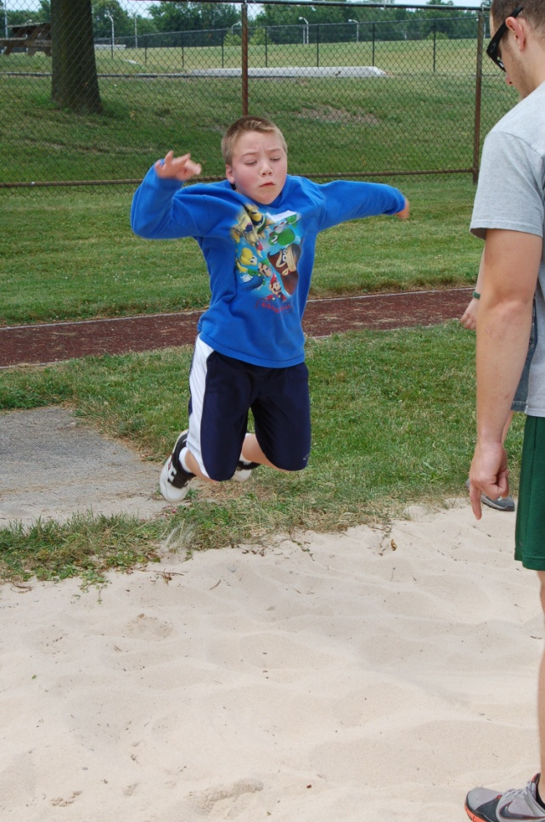
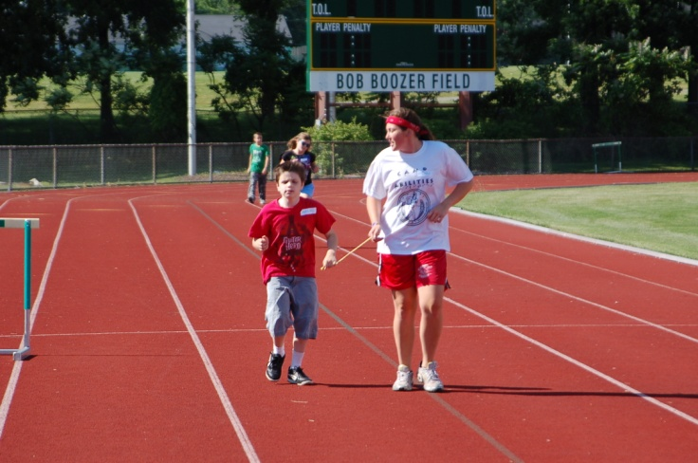
Why Are motor skills Important?
Notes:
Jessica

Slide 10
Foundations of sport
Notes:
Jessica

Slide 11
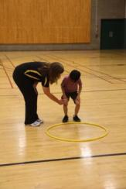
Developmental Progression of Locomotor Skills
Skipping
Sliding
Hopping
Galloping
Jumping
Running
Notes:
Jessica

Slide 12
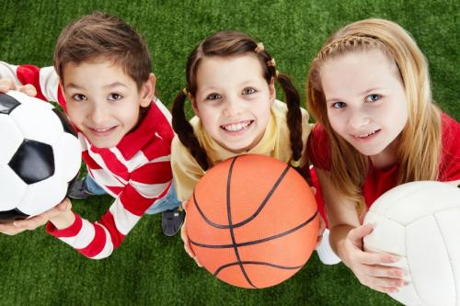
Foundation to Fitness
Physical activity levels at each life stage influence the child’s level of of engagement in sports, fitness, and recreational activities later on in life
Children’s skill competence is the primary, underlying mechanism that promotes engagement in physical activity

Slide 13
SPORTS OVERVIEW
LIST ALL OF THE SPORTS THAT YOU DO AT YOUR CAMP HERE

Slide 14
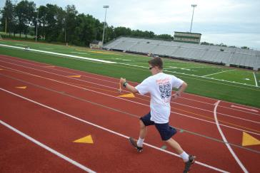
SPORT EXAMPLE: RUNNING
Make sure athletes know options – provide choice!
Guidewire, tether, human guide, sound source
Understand different running terrains might require different techniques
Stress proper form
Teach each component

Slide 15
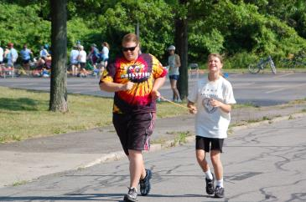
Guide Running Techniques
Be dynamic!
Progress from guidewire to tether etc.
Choice is important for skills to generalize to other environments
It is the guide's responsibility to provide verbal cues to the athlete on matters such as upcoming hills, turns, curbs, uneven footing, where other competitors are in the race, times, etc.
Guide’s ability must exceed or match the camper
It is important that the guide runner be a faster runner than the blind athlete
This will allow the guide to focus on the needs of the blind athlete and not be concerned with their ability to keep up the pace.
USABA Basics of Guide Running for Track & Field and Trail

Slide 16
TEACHING STRATEGIES
ASSESSMENT
PROMPTS
GUIDANCE: TACTILE MODELING, COACTIVE MOVEMENT, PHYSICAL GUIDANCE
BEHAVIOR STRATEGIES

Slide 17
Pre teaching: Whole – part - whole
The entire activity is presented first so that athletes understand what they are going to attempt to accomplish
The activity is then broken down into its component parts, which are taught and practiced
Finally, the athletes put the parts together into the whole activity or skill.
Example 1: Use tactile boards prior to exploring the field of play or court
Example 2: Show and explain equipment prior to teaching the unit

Slide 18
Pre teaching: hierarchy of Prompts
Natural Cue/ Independence
Visual Prompt
Verbal Prompt
Gestural Prompt
Modeling
Partial Physical Prompt
Full Physical Prompt
Most to least restrictive

Slide 19
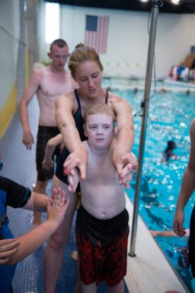
Instructional Strategies: Teaching techniques
Which is the athlete’s preferred method of learning?
Physical Guidance – instructor guides the athlete through the motions of a skill
Tactile Modeling – athlete feels the instructor or peer go through the motions of a skill
Coactive Movement - Both the instructor and athlete perform the same movement at the same time together

Slide 20
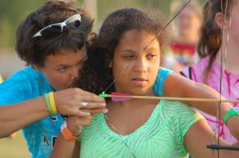
Instructional strategies Continued
Show athletes their options of teaching techniques
Ask the athlete what their preferred method of learning is
What are they comfortable with?
Let them know there are multiple ways to learn
Combine different techniques
Use appropriate cues
Let athlete know what you are doing before you do it!
Notes:
Jessica

Slide 21
MODIFICATIONS
WHAT IF THE SPORT/PROGRAM IS NOT MEETING THE NEEDS OF THE CHILD?
MODIFICATIONS/ADAPTATIONS
ACCOMMODATIONS

Slide 22
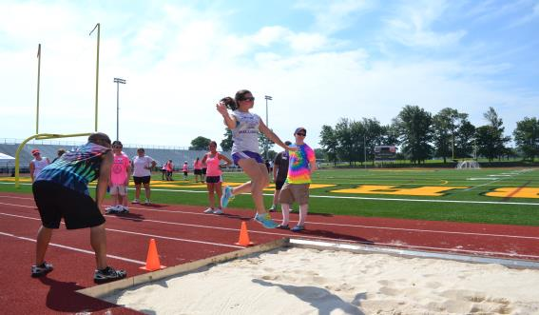
modifications
Understand B1, B2, and B3 classification related to sight and needs
Do not assume modifications needs to be made!
USABA Sport Adaptations

Slide 23
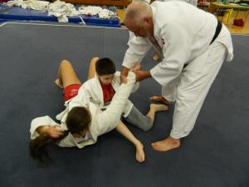
Environment Modifications
Tactile Boundaries
Bubble wrap boundaries
Uniforms can be brighter recognized colors
Size of the court
Can be made bigger or smaller to fit the needs of the athlete
Rules can change as long as they do not effect the main objective of the sport
Example: Wrestlers begin
by maintaining contact

Slide 24
Equipment Modifications
Brightly colored objects
Neon colored balls, bright scarves
Auditory objects
Ex. Beeping ball, sound box, ball with bells
Size of the object
Small vs. medium vs. large
Texture of the object
Yarn ball, Gatorball, playground ball

Slide 25
Instructional Modifications
Visual Prompts
Skill posters
Related cues
Examples
Level of Assistance
Total vs. partial

Slide 26
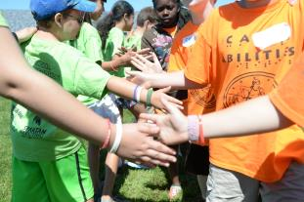
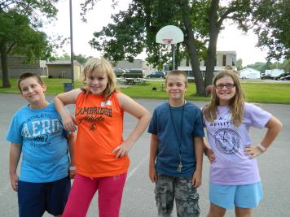
SOCIALIZATION FACILITATION
Teach appropriate socialization
Ex: How to begin conversation
Interactions between athletes
Encourage athletes to sit with peers at meals
Encourage athletes to walk to activities with peers
Facilitate pairs when needed to prevent cliques
Encourage contact info. exchange between athletes after camp
Email
Facebook
Provide contact information for all
Athletes to ensure continues relationships
Notes:
Adam

Slide 27
ADVOCACY
SOME WAYS TO FACILITATE HAVING CHILDREN WITH VI PARTICIPATE BEYOND CAMP…
Role play scenarios
Provide athletes with scripts
Guest Speakers
Paralympians
Testimonials
Former Campers & Paralympians
Panels
Campers & Parlympians
Individuals from the community

Slide 28
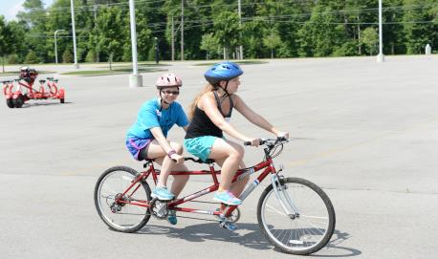
How to ensure involvement in sports
Give opportunities – afterschool, camps, within community
Train coaches (tip sheets from USABA)
Teach the students advocacy
Support parent needs
Notes:
Lavelle slide**requirement for NYS camps

Slide 29
CONCLUSIONS
REMEMBER YOUR PURPOSE
INFILTRATE YOUR MISSION INTO EVERY ACTIVITY
FOCUS ON THE OBJECTIVES OF YOUR CAMP IN ADVERTISEMENTS, TV AND OTHER MEDIA

Slide 30
Resources
Athletics For All
USABA Mobile Coach
Leveling The Playing Field
Beep Kickball
US Games
Flaghouse
The Braille Superstore
American Printing House For The Blind

